Slide 1
Signal Processing
Tirgul 3 – Decibels,Noise Reduction, cross-correlation and convolution

Slide 2
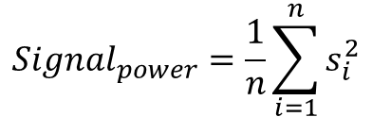
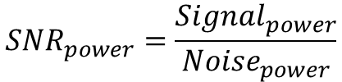
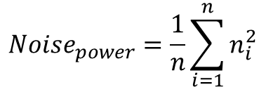
SNR
SNR – Signal to Noise Ratio

Slide 3
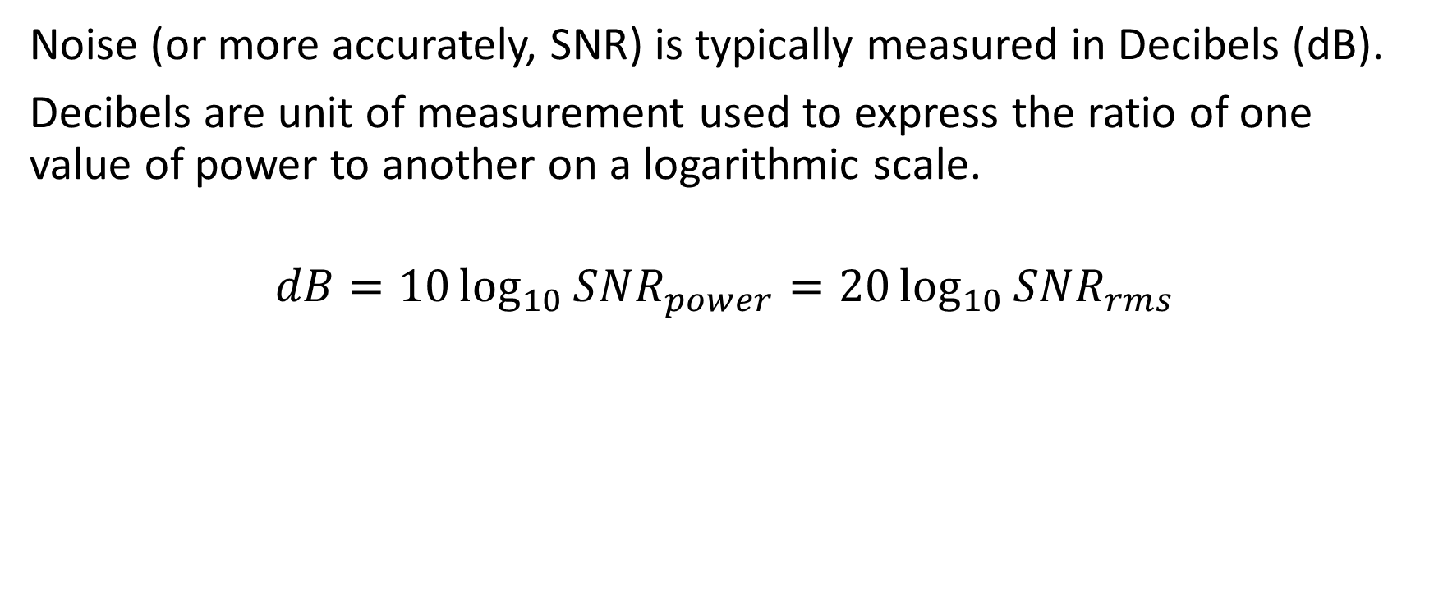
Decibel (dB)

Slide 4
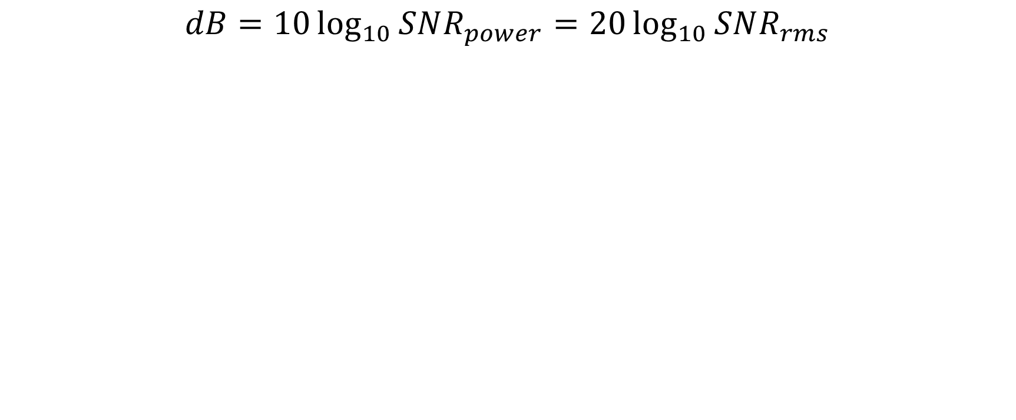
Decibel (dB)
SNR_{power} = 1 🡺 SNR_{rms} = 1 🡪 dB = 0
SNR_{power} = 10 🡺 SNR_{rms} = 3.3 🡪 dB = 10
SNR_{power} = 100 🡺 SNR_{rms} = 10 🡪 dB = 20
SNR_{power} = 2 🡺 SNR_{rms} = 1.7 🡪 dB = ~3
SNR_{power} = 5 🡺 SNR_{rms} = 2.2 🡪 dB = ~7
SNR_{power} = 0.5 🡺 SNR_{rms} = 0.7 🡪 dB = -3
SNR_{power} = 1/5 🡺 SNR_{rms} = 0.4 🡪 dB = ?

Slide 5
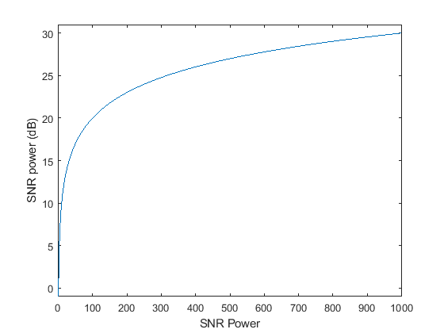
Decibel (dB)

Slide 6
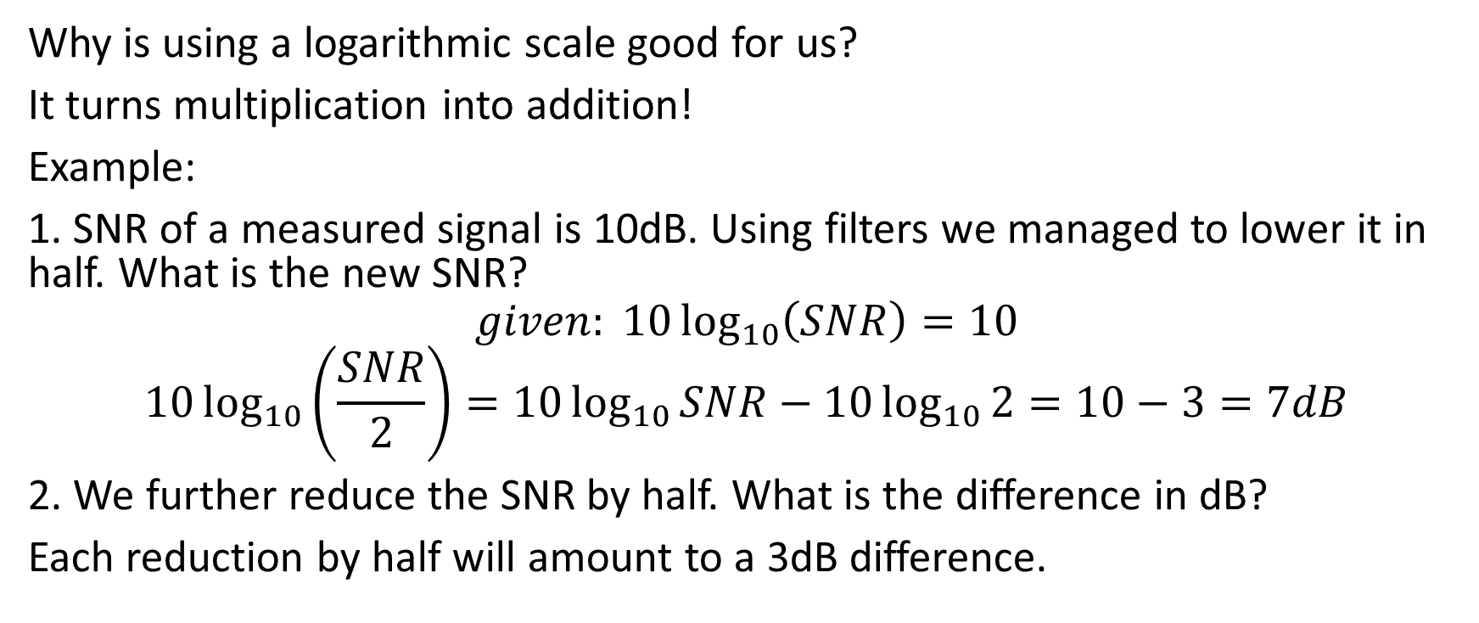
Decibel (dB) – Example 1

Slide 7
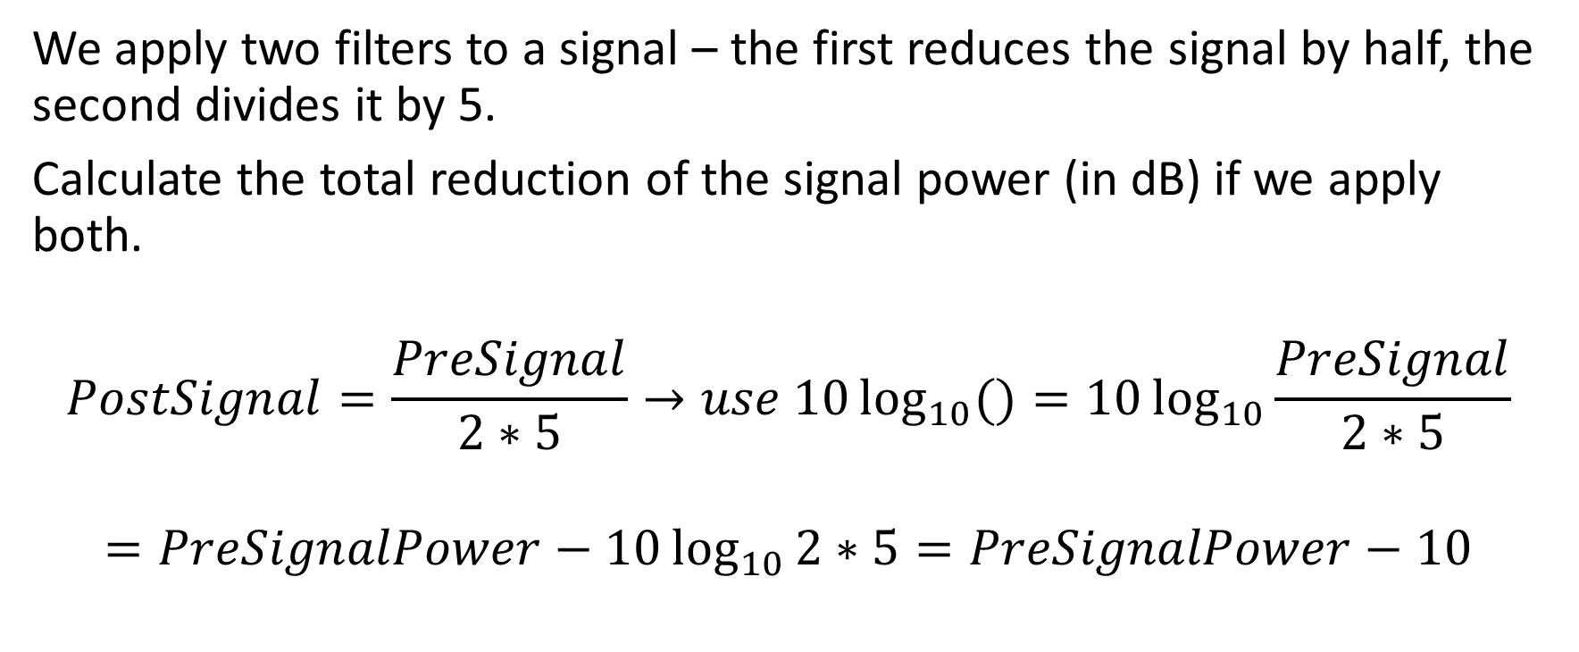
Decibel (dB) – Example 2

Slide 8
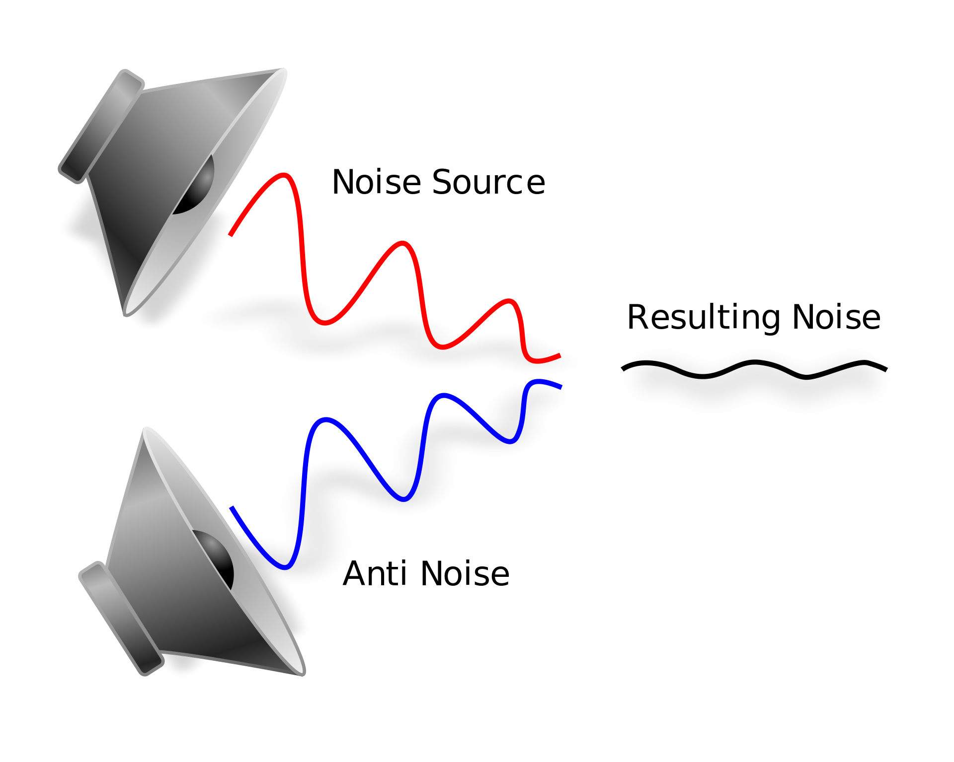
Noise Reduction

Slide 9
Noise Reduction = increasing the SNR
Oversampling
Averaging over trials (repetitions of the same stimulus)
Averaging over time (smoothing)

Slide 10
Oversampling
One way to reduce the noise in our signal is called ‘Oversampling’.
In this method, we increase the sampling frequency (Fs, e.g. we will sample the signal in Fs=10KHz instead of 1KHz).
Now we can average every N points (e.g. N = 10), such that we will reduce the noise around each point by sqrt(N).
See code example

Slide 11
Noise Reduction = increasing the SNR
Oversampling
Averaging over trials (repetitions of the same stimulus)
Averaging over time (smoothing)

Slide 12
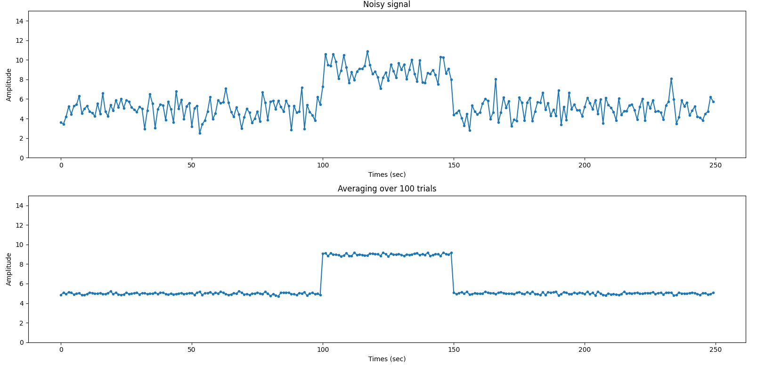
Averaging over trials
See example code

Slide 13
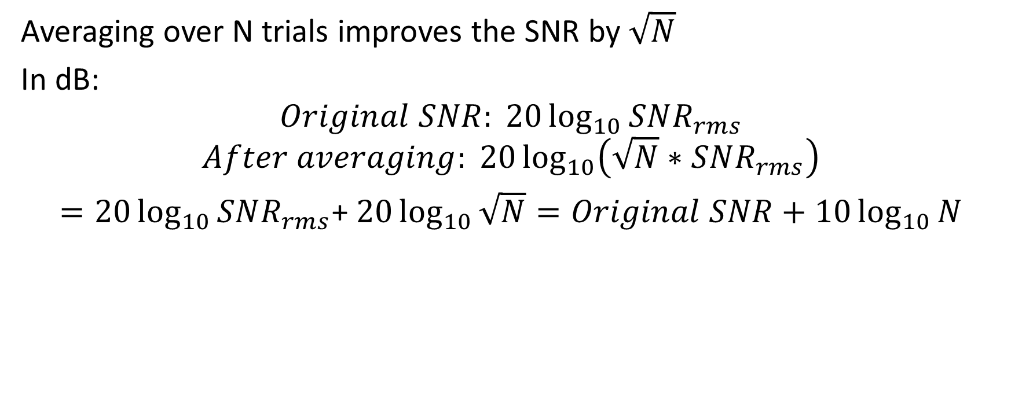
Averaging over trials – effect on SNR

Slide 14
Noise Reduction = increasing the SNR
Oversampling
Averaging over trials (repetitions of the same stimulus)
Averaging over time (smoothing)

Slide 15
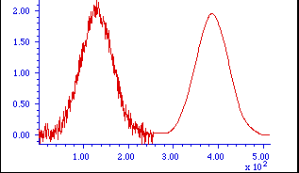
Smoothing
Normalizing the value of the signal with the values preceding and following it.
Acts as a low pass filter – removes fast fluctuations from the signal, capturing long term patterns.
Before smoothing
After

Slide 16
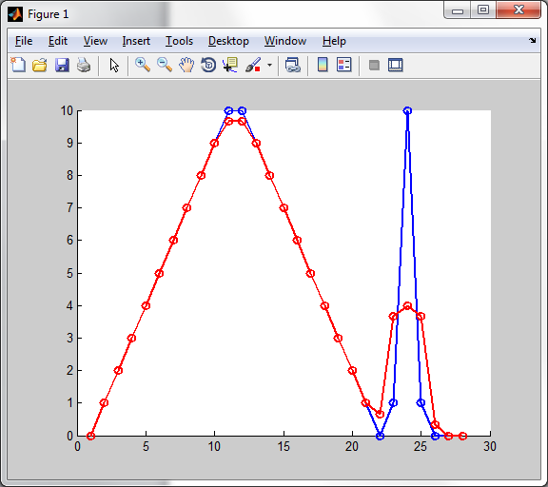
Smoothing is a “low pass filter”
Original signal
Smooth(x,4)

Slide 17
Smoothing
We usually select odd number of points for our window size. This is because we center our window around each point of the signal.
The sum of the coefficients is 1. We normalize the coefficients by the window size.
x₉
x₃
x₄
x₇
x₈
x₅
The signal
x₆
x₂
x₁
1/5
The coefficients
0

Slide 18
Rectangle Smoothing
Rectangle window (Example – window size = 5):
In the reconstructed signal, for each time point i:
x_{i} = (x_{i-2} + x_{i-1} + x_{i} + x_{i+1} +x_{i+2})/5
In a rectangle window each point gets the same weight (uniform, 1/N).
We pad the edges of the signal with zeros, so we can smooth it from its beginning (we add (N-1)/2 zeros for each side).

Slide 19
Triangle Smoothing
Triangular window (Example – window size = 5):
In the reconstructed signal, for each time point i:
x_{i} = (x_{i-2} + 2x_{i-1} + 3x_{i} + 2x_{i+1} +x_{i+2})/9
We normalize by the sum of the coefficients (1+2+3+2+1 = 9).
The idea is that distant points contribute less.
Each point at the same distance from the middle of the window gets the same weight.

Slide 20
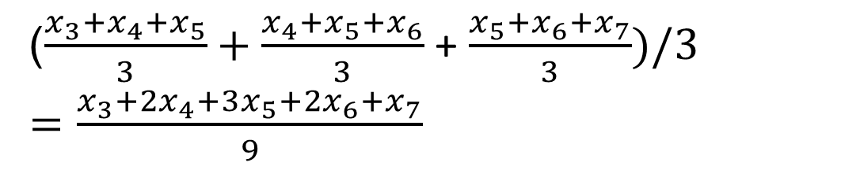
Multiple smooth passes
Smoothing twice with a rectangular is the same as once with a triangular
The general rule: n passes with a rectangular window of size w is the same as one pass with a triangular window of :
n*(w-1)+1
2*(3-1)+1 = 5
X₅ after first pass

Slide 21
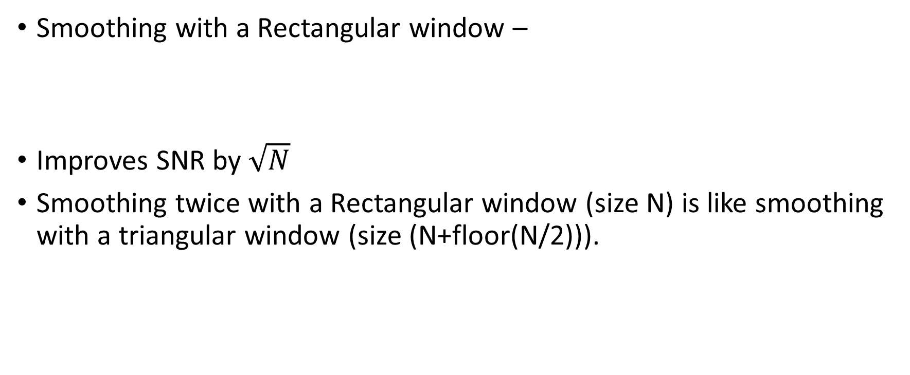
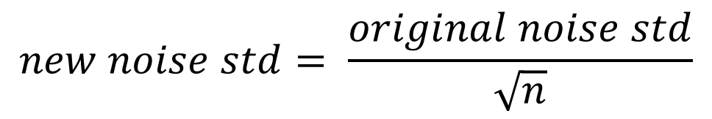
Smoothing – effect on SNR
Same effect on SNR as we got using averaging

Slide 22
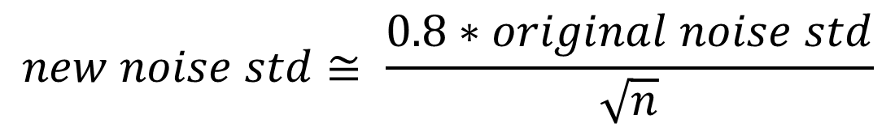
Smoothing – effect on SNR
What is the improvement in the SNR following smoothing with a triangular window?

Slide 23
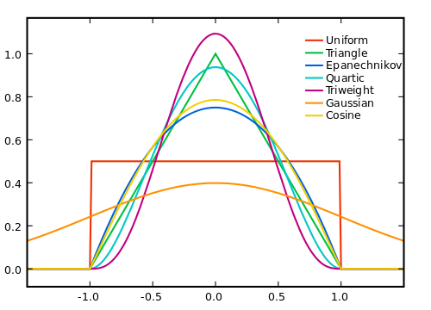
Many kinds of windows (AKA kernels)
Wikipedia

Slide 24
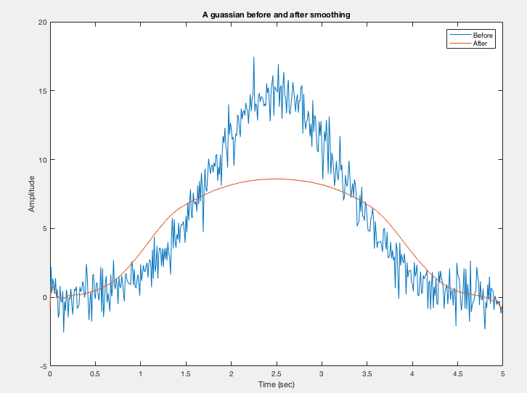
Smoothing can sometimes destroy the signal

Slide 25
Smoothing in numpy
y = np.convolve(window / np.sum(window), x, mode='same')
the line of code applies convolution to the input signal x using a normalized window array, and it returns the smoothed output signal y. The normalization of the window array ensures that the smoothing effect is applied uniformly across the signal. The convolution operation performs the actual smoothing by calculating the weighted sum of the signal values around each point. The mode='same' argument ensures that the output has the same shape as the input signal, and the result is stored in y.

Slide 26

Cross Correlation and Convolution

Slide 27
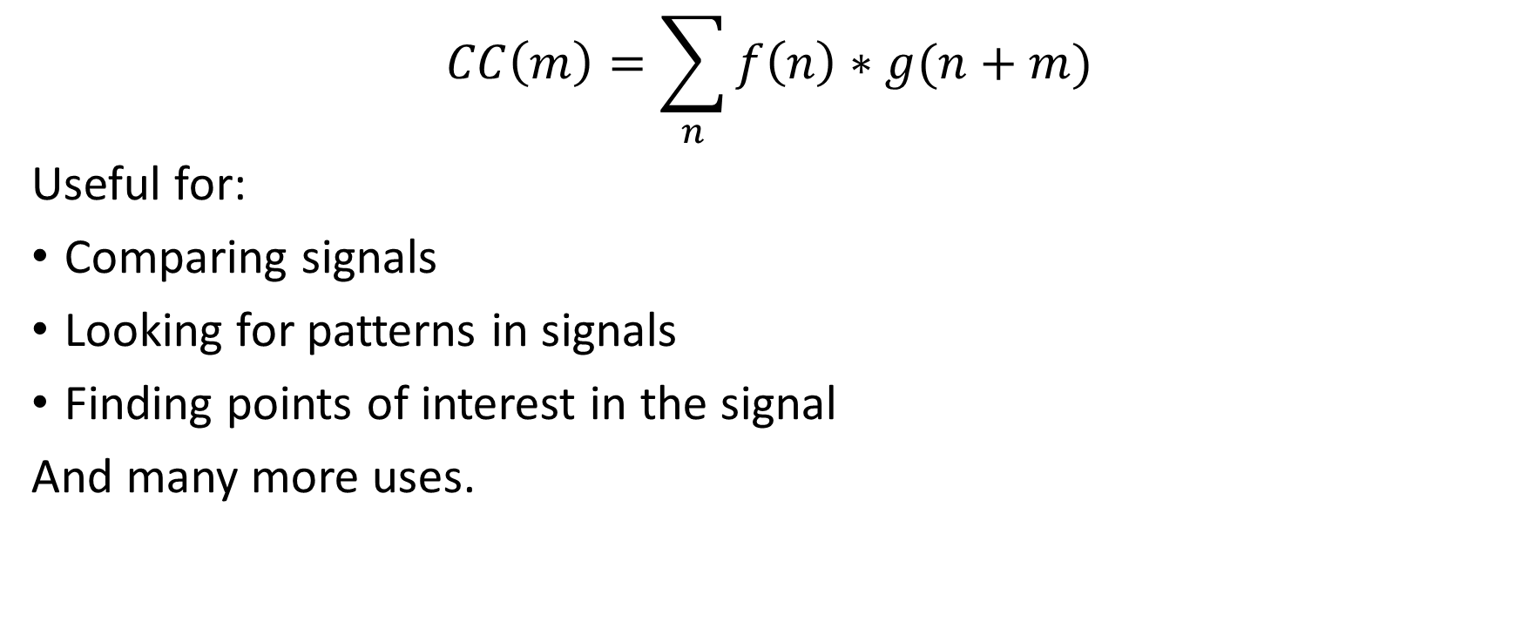
Cross Correlation
np.correlate(x, y, "full")

Slide 28
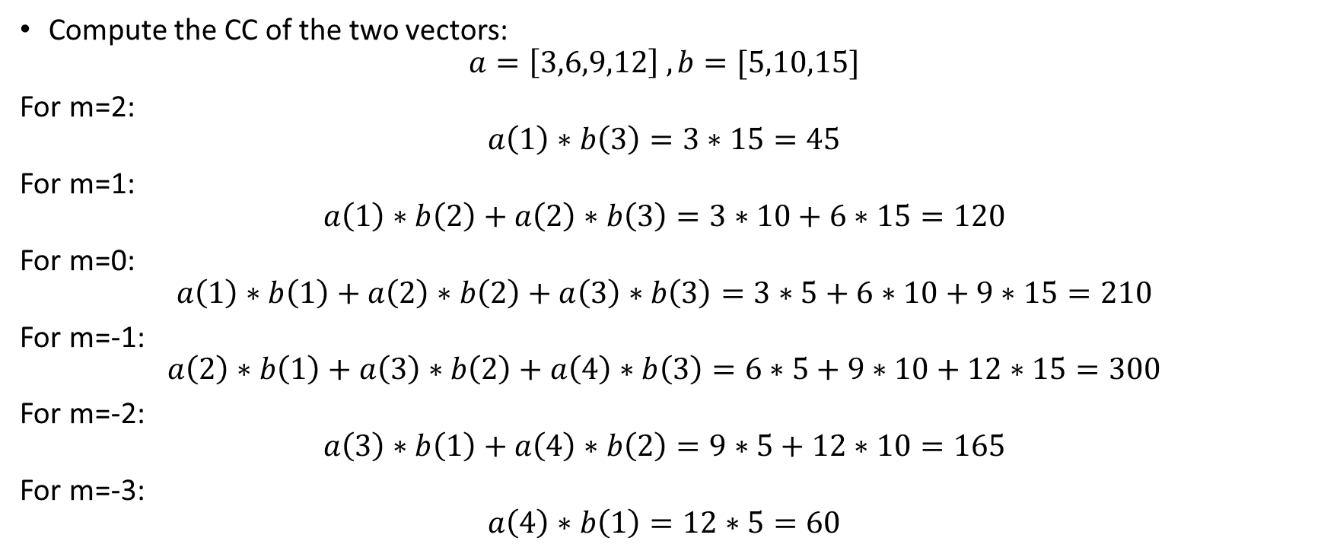
Example - Computing a CC

Slide 29
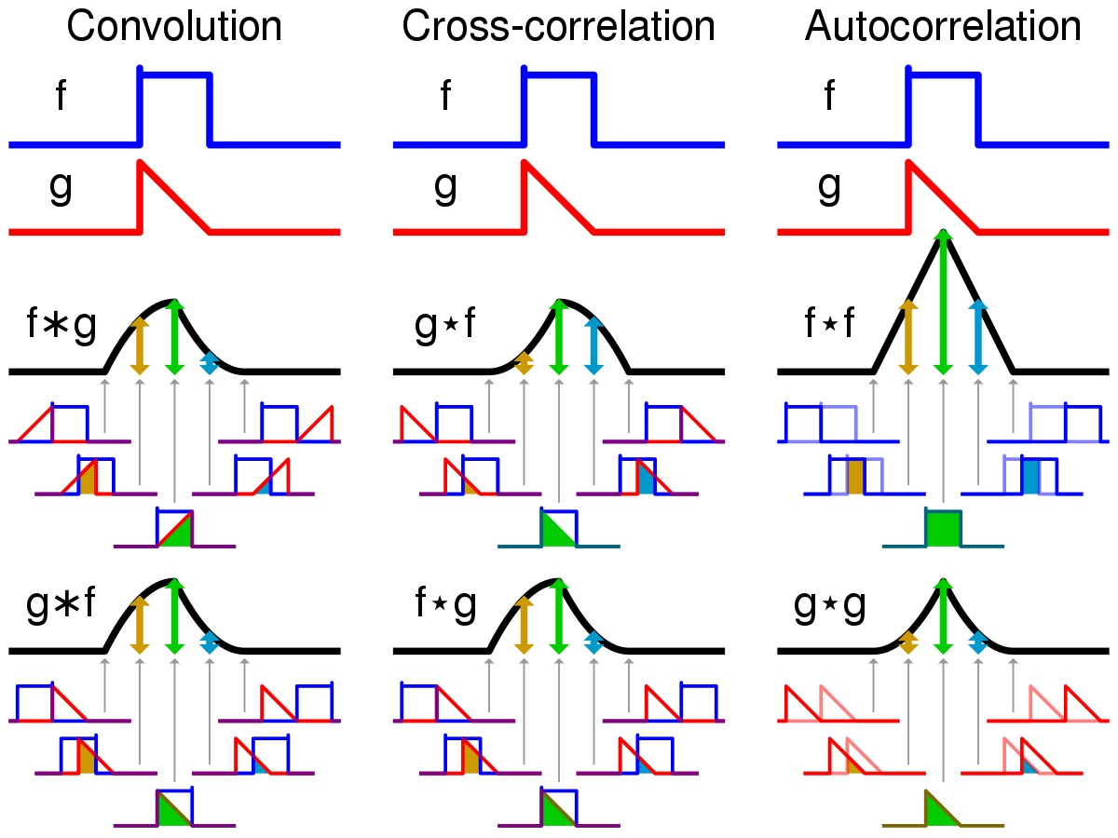
CC is not symmetric!
Signal A
Signal B
Signal B
Signal A

Slide 30
CC is a similar linear operation to Smoothing
We compute the cross-correlation between our signal (N points) and the window (which is another signal with K points).
The smoothed signal is the result of the cross-correlation.
The dimension of the CC result is N+K-1

Slide 31
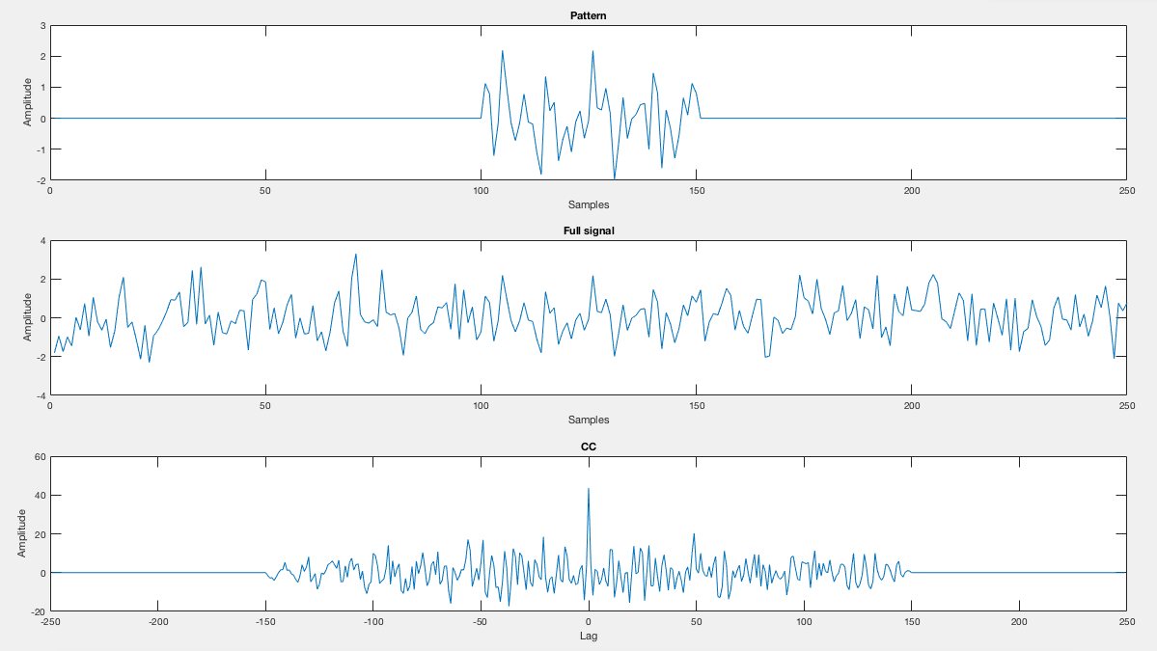
Finding shift between signals using CC
CC result
Length of 250+250-1
Time (ms)

Slide 32

Convolution
A mathematical operation on two functions that produces a third function that expresses how the shape of one modified the other. same as CC , but one of the signals is reflected about the y - axis (doesn’t matter which one - commutative).

Slide 33
Convolution VS cross-correlation
Wikipedia

Slide 34
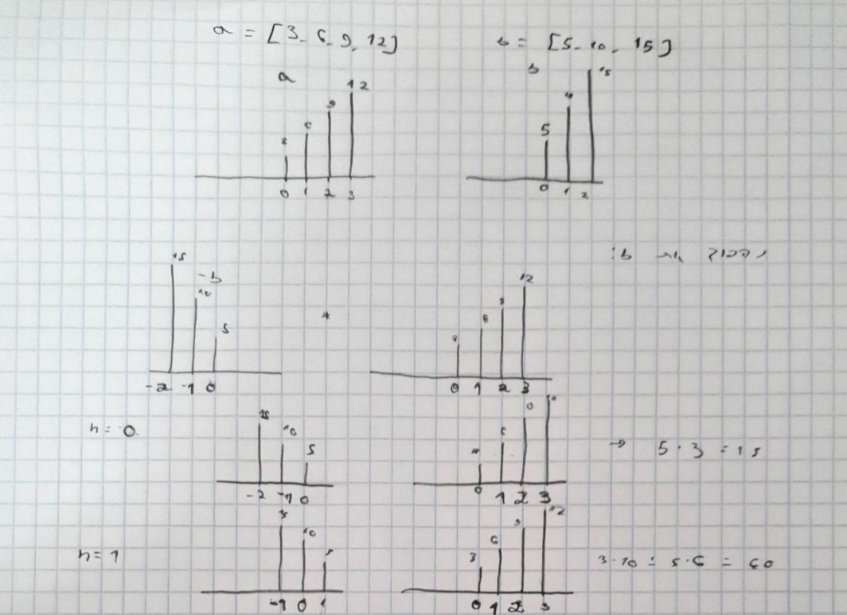
Convolution - example
same example as CC :

Slide 35
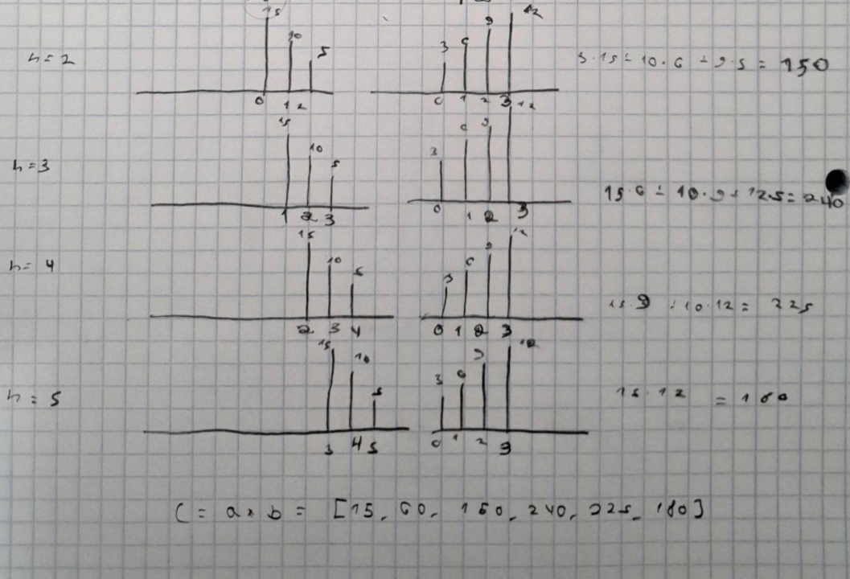
Convolution - example

